Slide 1

Cybersecurity club

Slide 2

AGENDA
Cybersecurity News
Databases
SQL?
SQL Fundies
Social Media
Questions

Slide 3
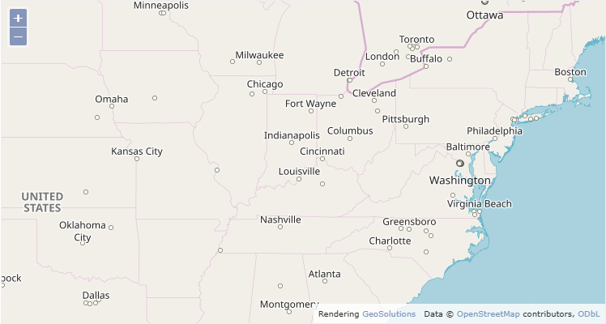
Cybersecurity News
GeoServer exploit: CVE-2025-58360
  XML External Entity (XXE) vulnerability
  unauthenticated attackers perform arbitrary file reads on the host server and Server-Side Request Forgery (SSRF)
  Allows hacker to change Geolocation maps and read customer information on a server
Has been patched now

Slide 4

Databases
Databases are an organized collection of structured information or data that is easily accessible and can be manipulated or analyzed
  Many forms of data (username, passwords, Instagram likes)
Different Types of Databases
  Relational (SQL) and non-relational (NoSQL)
  Table-based Graph, key-value, document, etc.
  Structured Varied data

Slide 5
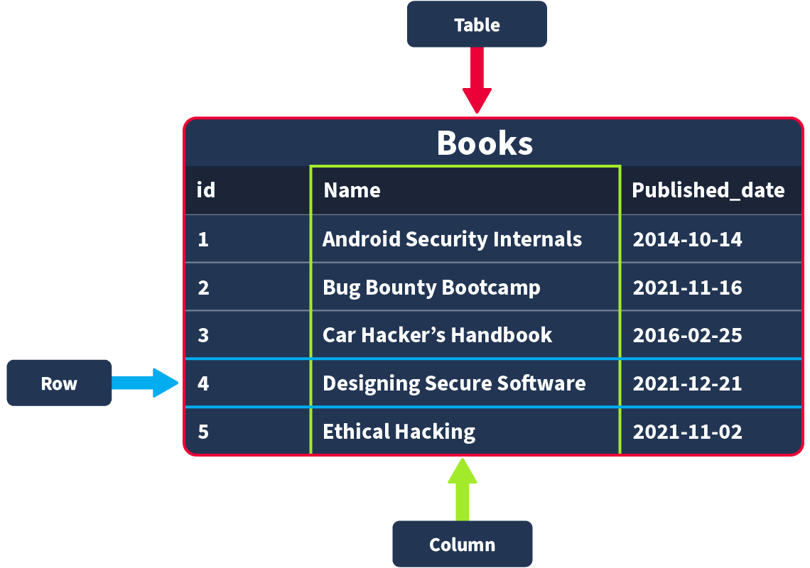
Relational Database
All data will be stored on a table
    Define important information (id, name, Published_date)
    These will be the columns
    If you try to add data that doesn’t match, it is rejected
Data can be in String, Integer, floats/decimals, and Time/Dates formats
Records are fully filled out data
    These will be the rows

Slide 6
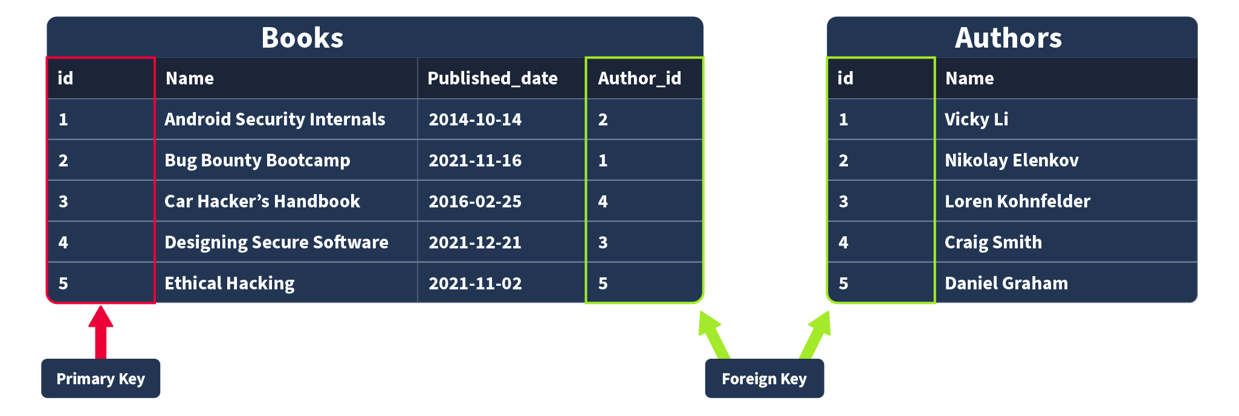
Relational Database
If you want to store data from another table, use Foreign keys
Primary keys
    Used to ensure that the data collected in a certain column is unique
Foreign keys
    A table that also exists in another table within the database
    This links tables together

Slide 7

SQL?
People manage databases with Database Management System (DBMS)
    Some DBMS are MySQL and MongoDB
To interact with a database, we can use SQL (Structured Query Language)
    It queries, defines, and manipulates data
Why SQL?
    Its fast, easy to learn, reliable, and flexible

Slide 8
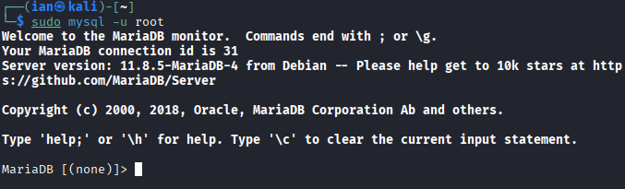
Hands on (Download)
Download packages for MySQL
    sudo apt install default-mysql-server –y
Start the service
    sudo service mysql start
Access MySQL
    sudo mysql -u root

Slide 9
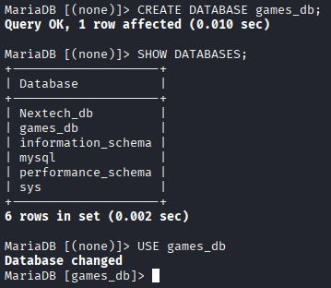
Hands on (Create database)
Create a database
  mysql> CREATE DATABASE database_name;
Show the databases
  mysql> SHOW DATABASES;
Use the database
  mysql> USE thm_bookmarket_db;
  Use DROP database database_name; to remove a database

Slide 10
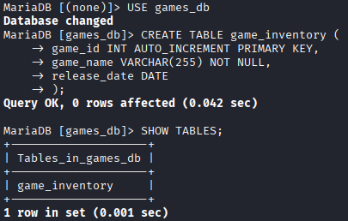
Hands on (Create tables)
Create a table
  mysql> CREATE TABLE example_table_name (
  example_column1 data_type,
  example_column2 data_type,
  example_column3 data_type
  );
  An example would be
  mysql> CREATE TABLE game_inventory (
  game_id INT AUTO_INCREMENT PRIMARY KEY,
  game_name VARCHAR(255) NOT NULL,
  release_date DATE
  );

Slide 11
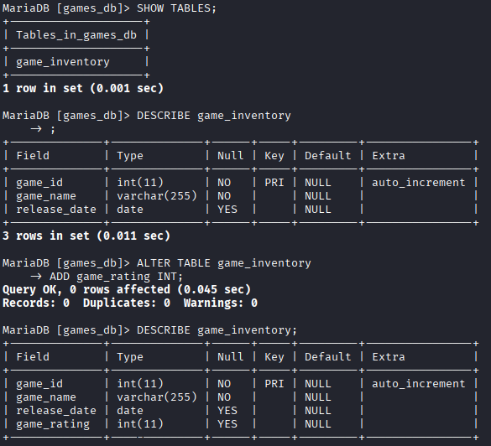
Hands on (Tables)
Show the tables
  mysql> SHOW TABLES;
Describe the table
  mysql> DESCRIBE table_name;
Alter the table
  mysql> ALTER TABLE game_inventory
  ADD game_rating INT;
Drop the table
  mysql> DROP TABLE table_name;

Slide 12
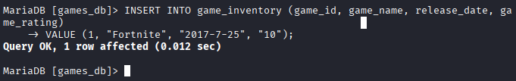
CRUD
CRUD
    Create, Read, Update, and Delete
    All basic operations data management
Create (INSERT)
mysql> INSERT INTO game_inventory (game_id, game_name, release_date, game_rating)
VALUES (1, "Fortnite", "2017-7-25", "10");
This will create a game with an id of 1, name "Fortnite", release date of "2017-7-25" and a rating of "10"

Slide 13
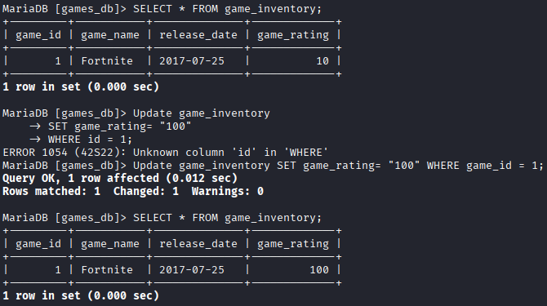
CRUD
Read Operation (SELECT)
mysql> SELECT * FROM game_inventory;
    This will read the information
    SELECT with "*" symbol indicate columns should be received, then from the table
    To specify a column change * to column name (name or rating)
Update Operation (UPDATE)
mysql> UPDATE game_inventory
SET game_rating= "100"
WHERE game_id = 1;

Slide 14

CRUD
Delete Operation (DELETE)
mysql> DELETE FROM game_inventory WHERE game_id = 1;
CRUD summary
    Create (INSERT statement) - Adds a new record to the table
    Read (SELECT statement) - Retrieves record from the table
    Update (UPDATE statement) - Modifies existing data in the table
    Delete (DELETE statement) - Removes record from the table

Slide 15

Importing and exporting
Importing
  sudo mariadb new_db < imported_db.sql
Exporting
sudo mariadb-dump -u root -p db_name > db_name.sql
Import cyberclub_db.sql to mariadb for the lab
Go to the worksheet and answer the question 1 and 2

Slide 16
Clauses
A clause is a statement that specifies data being manipulated
    We have used FROM and WHERE
DISTINCT Clause
    Used to avoid duplicate records
mysql> SELECT DISTINCT column FROM table;
GROUP BY Clause
    Gets data from multiple records and groups them
mysql> SELECT column, COUNT(*)
FROM table
GROUP BY column;
ID name release_date description
1 Mario 1985-9-13 Platformer
2 Zelda 1986-2-21 RPG
3 Fortnite 2017-7-25 FPS
4 Super Mario 2006-5-15 Platformer
5 Kirby 1992-4-27 Platformer
6 Kirby 1992-4-27 Platformer
Name Name count(*)
Mario Mario 1
Zelda Zelda 1
Fortnite Fortnite 1
Super Mario Super Mario 1
Kirby Kirby 2

Slide 17
clauses
ID name release_date description
1 Mario 1985-9-13 Platformer
2 Zelda 1986-2-21 RPG
5 Kirby 1992-4-27 Platformer
6 Kirby 1992-4-27 Platformer
4 Super Mario 2006-5-15 Platformer
3 Fortnite 2017-7-25 FPS
Name COUNT(*)
Mario 1
Super Mario 1
ORDER BY Clause
    Used to sort records (ASC or DESC)
mysql> SELECT *
FROM table
ORDER BY published_date ASC;
HAVING Clause
    Used to filter groups
mysql> SELECT name, COUNT(*)
FROM games
GROUP BY name
HAVING name LIKE '%Mario%';

Slide 18
Operators
Operators are our way to filter and manipulate data effectively
Logical Operators
    LIKE Operator
    LIKE is often used with WHERE clauses
mysql> SELECT *
FROM games
WHERE name LIKE "%Mario%";
ID name release_date description
1 Mario 1985-9-13 Platformer
4 Super Mario 2006-5-15 Platformer

Slide 19
Operators
ID name release_date description
4 Super Mario 2006-5-15 Platformer
ID name release_date description
1 Mario 1985-9-13 Platformer
2 Zelda 1986-2-21 RPG
4 Super Mario 2006-5-15 Platformer
AND Operator
    AND uses multiple conditions and if TRUE returns them all
mysql> SELECT *
FROM games
WHERE category = "Mario" AND name = "Super";
OR Operator
mysql> SELECT *
FROM games
WHERE name LIKE "%Mario%" OR name LIKE "%Zelda%";

Slide 20
Operators
NOT Operator
mysql> SELECT *
FROM games
WHERE NOT category LIKE "%Mario%";
BETWEEN Operator
mysql> SELECT *
FROM games
WHERE id BETWEEN 2 AND 4;
ID name release_date description
2 Zelda 1986-2-21 RPG
3 Fortnite 2017-7-25 FPS
5 Kirby 1992-4-27 Platformer
6 Kirby 1992-4-27 Platformer
ID name release_date description
2 Zelda 1986-2-21 RPG
3 Fortnite 2017-7-25 FPS
4 Super Mario 2006-5-15 Platformer

Slide 21
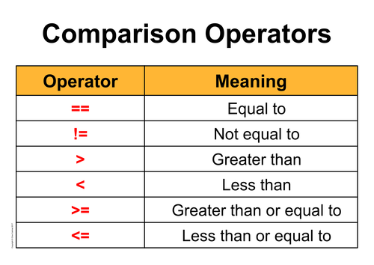
Operators
Comparison Operators
Equal To Operator
WHERE name = "Mario";
Not Equal To Operator
WHERE category != "Mario";
Less Than Operator
WHERE release_date < "2020-01-01";
Greater Than Operator
WHERE release_date > "2020-01-01";
Less Than or Equal To and Greater Than or Equal To Operators
WHERE release_date <= "2019-01-01";
WHERE release_date >= "2021-01-01";

Slide 22
Functions
String Functions
  CONCAT() Function
    Adds two or more strings together
mysql> SELECT CONCAT(name, " is a type of ", description, " game.") AS game_info FROM games;
  Group_CONCAT() Function
    concatenates data from muliple rows
mysql> SELECT category, GROUP_CONCAT(name SEPARATOR ", ") AS games
FROM games
GROUP BY category;
Game_info
Mario is a type of platformer
Zelda is a type of RPG
Fortnite is a type of FPS
Super Mario is a type of platformer
Kirby is a type of platformer
Kirby is a type of platformer
description game
Platformer Mario, Super Mario, Kirby, Kirby
RPG Zelda
FPS Fortnite

Slide 23
Functions
Release_date
1986-2-21
2017-7-25
2006-5-15
1992-4-27
1992-4-27
name_length
5
5
8
11
5
5
  SUBSTRING() FUNCTION
    Retrieve a substring and output anything with that substring
mysql> SELECT SUBSTRING(release_date, 2, 4) AS release_year FROM games;
  LENGTH() Function
    Returns the number of character in a string (includes spaces and punctuation)
mysql> SELECT LENGTH(name) AS name_length FROM games;

Slide 24
FUNCTIONS
Aggregate Functions
    Value of multiple rows with one criteria
  COUNT() Function
mysql> SELECT COUNT(*) AS total_games FROM games;
  SUM() Function
mysql> SELECT SUM(price) AS total_price FROM games;
total_games
6
total_price
90

Slide 25
Functions
latest_game
2017-7-25
earliest_game
1985-9-13
  MAX() Function
mysql> SELECT MAX(release_date) AS latest_game FROM games;
  MIN() Function
mysql> SELECT MIN(release_date) AS earliest_game FROM games;

Slide 26
Finish the worksheet!

Slide 27

Conclusion
We learned
  Databases a collection of organized data
  Relation databases tables
  SQL an easy to learn programing language that is relational
  CRUD, Create, Read, Update, and Delete
  Clauses define how data is retrieved
  Operators and functions help filter and manipulate data

Slide 28



Social Media
Instagram
Discord
https://dsc.gg/bsucyber
Be Connected
(Attendance)

Slide 29

Questions

